Slide 1
Forces
Contact and Non-Contact

Slide 2
What is a Force?
We cannot see forces – we can only see the effect of the force.
If there is no force, then:
a stationary object will remain still
a moving object will remain moving at a steady speed, in a straight line.
To move or stop an object, we must push or pull on it – these are forces.

Slide 3
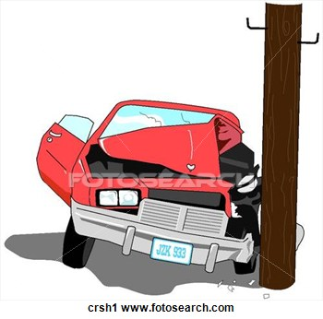
Changing Shape
Forces may change the shape of an object.

Slide 4
Changing Direction
Forces can also change the direction in which an object is moving.

Slide 5
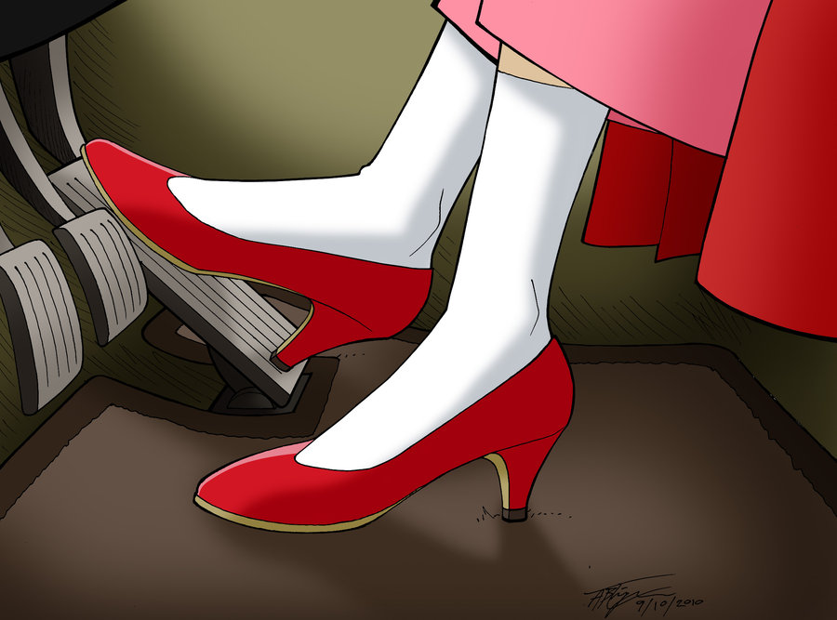
Changing Speed
Forces can change the speed of an object that is already moving.

Slide 6
Contact Forces
Forces that act on contact with objects.
Elastic Force
Collision Force
Friction Force

Slide 7
Non-Contact Forces
Forces that act at a distance from objects.
Gravitational Force
Magnetic Force
Electrical Force

